Slide 1

Data Structre CSe207 Instructor: Md Manowarul Islam
Cafeteria Management System

Slide 2


OUR TEAM
Md Ashik Miah
Ripon chandra saha
ID:2020-3-60-032
Department of Computer Science & Engineering
ID:2020-1-60-233
Department of Computer Science & Engineering

Slide 3
Introduction
Welcome to the presentation on our Data Structure project.
In this project, we have implemented a data structure-based solution for managing orders in a restaurant.
Our goal was to create an efficient and organized system to handle both admin order menu and customer orders.
By utilizing linked lists, we have designed a solution that allows for easy creation, deletion, and display of orders.
Throughout this presentation, we will provide an overview of the code structure and highlight key functions and their functionalities.
Let's dive into the details of our Data Structure Project.

Slide 4
Code overview
The code provided is a data structure project that utilizes linked lists for data management.
Linked lists are a fundamental data structure consisting of nodes connected together through pointers.
In this project, two types of linked lists are used: one for the admin order menu and another for the customer order.
Linked lists are chosen for their dynamic nature, allowing for efficient insertion, deletion, and traversal of elements.
The code demonstrates the implementation of various functions for creating, deleting, and displaying elements in the linked lists.
It also includes functions for calculating and displaying the bill for the customer order.
Additionally, the code provides functionality for saving and loading the admin order menu to/from a file.
By utilizing linked lists, the code offers flexibility and scalability for managing orders in a restaurant or similar setting.
The project showcases the practical application of data structures and their importance in efficient data organization and manipulation.

Slide 5
Data Structure
Code
struct adminnode {
int data;
char foodname[50];
float price;
struct adminnode *next;
};
In the cafeteria order management system, the following data structures are used:
Struct "adminnode":
Represents an admin order menu item.
Fields:
data (item number): Unique identifier for the menu item.
foodname (food item name): Name of the menu item.
price: Price of the menu item.
next: Pointer to the next item in the admin order menu list.

Slide 6
Data Structure
Code
struct customernode {
int data;
int quantity;
struct customernode* next;
};
Struct "customernode":
Represents a customer order item.
Fields:
data (item number): Unique identifier for the menu item.
quantity: Quantity of the menu item ordered by the customer.
next: Pointer to the next item in the customer order list.

Slide 7
Functions
Slide 4: Admin Order Menu Functions:
- createadmin: Creates a new admin order menu item.
- deleteadmin: Deletes an item from the admin order menu.
- displayadmin: Displays the admin order menu.
- saveAdminMenuToFile: Saves the admin order menu to a file.
- loadAdminMenuFromFile: Loads the admin order menu from a file.
Slide 5: Customer Order Functions:
- createcustomer: Creates a new customer order item.
- deletecustomer: Deletes an item from the customer order.
- displaycustomer: Displays the customer order.
- displaybill: Displays the bill for the customer order.

Slide 8
Functions
The cafeteria order management system provides the following functionalities:
Creating a new admin order menu item:
Function: createadmin()
Parameters: head (pointer to the head of the admin order menu list), itemno, foodname, price
Creates a new adminnode and adds it to the end of the admin order menu list.
Creating a new customer order item:
Function: createcustomer()
Parameters: head (pointer to the head of the customer order list), itemno, quantity
Creates a new customernode and adds it to the end of the customer order list.
Deleting an item from the admin order menu:
Function: deleteadmin()
Parameters: head (pointer to the head of the admin order menu list), itemno
Deletes the adminnode with the specified itemno from the admin order menu list.
Deleting an item from the customer order:
Function: deletecustomer()
Parameters: head (pointer to the head of the customer order list), itemno
Deletes the customernode with the specified itemno from the customer order list.

Slide 9
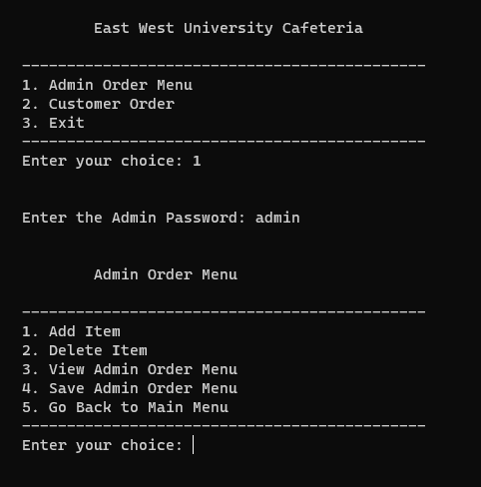
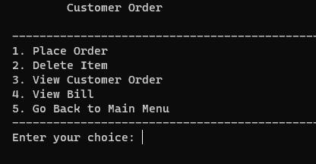
Main Function:
Initializes admin order menu from file.
Provides admin and customer order management menu.
Admin Menu:
Password required for access.
Add, delete, and view admin order menu items.
Save admin order menu to file.
Customer Order Menu:
Place orders, delete items, view order.
Generate bill.

Slide 10
File operations
saveAdminMenuToFile:
Functionality: Writes the admin order menu items to a file named "admin_menu.txt".
Parameters: None.
Returns: None.
File Name: "admin_menu.txt".
loadAdminMenuFromFile:
Functionality: Reads the admin order menu items from the file "admin_menu.txt".
Parameters: None.
Returns: Updated list of admin order menu items.
File Name: "admin_menu.txt".

Slide 11

User inerface
Displaying Menu Options:
The program presents menu options to the user.
Example Code:
printf("Menu Options:\n");
printf("1. Add item to order\n");
printf("2. Delete item from order\n");
printf("3. View order\n");
printf("4. Generate bill\n");
printf("5. Exit\n");
The program uses scanf() function to read user input.
Example code:
int option;
printf("Enter your choice: ");
scanf("%d", &option);

Slide 12
Conclusions
Conclusion:
- The provided code demonstrates a basic implementation of an order management system.
- It includes features for admin and customer interactions, such as adding, deleting, and viewing order items.
- File operations for loading and saving the admin order menu are also supported.
- Additional enhancements can be made to improve reliability and user experience.
- With further development, the program can be customized to meet specific requirements and provide a seamless ordering experience.

Slide 13
Thank you

